Slide 1
K-Means Clustering

Slide 2
What is it?
Clustering algorithms are used to group data instances according to some notion of similarity
K-means clustering specifically is a clustering method used to partition the dataset into k groups based on said notion of similarity
Traditionally viewed as an unsupervised method for data analysis but with enough background information, this algorithm can be useful in data analysis
We have different conditions in our dataset, for example resting vs exercise
Notes:
https://web.cse.msu.edu/~cse802/notes/ConstrainedKmeans.pdf

Slide 3
Algorithm that we will use
The specific algorithm that we will use is called Lloyd algorithm
It proceeds by selecting k initial cluster centers and then iteratively repeat:
Group each data point with the closest center
Recalculate new centers for each cluster using the mean of all points in the cluster
Group each data point with the new closest center
Each time this is performed, the points are left in a slightly more even distribution, closer to its final cluster
Notes:
https://web.cse.msu.edu/~cse802/notes/ConstrainedKmeans.pdf

Slide 4
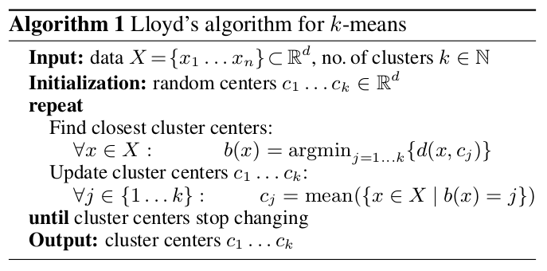
Function for clustering process
Notes:
https://avira.github.io/dsblog/2016-09-01-speeding-up-k-means.html

Slide 5
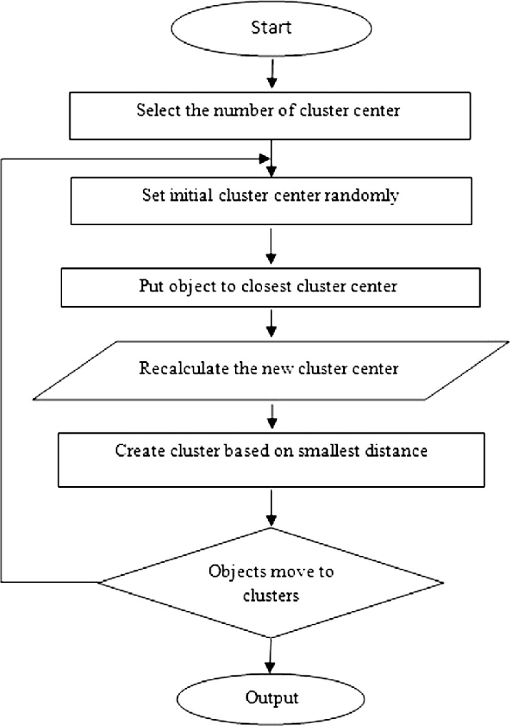
Pipeline

Slide 6
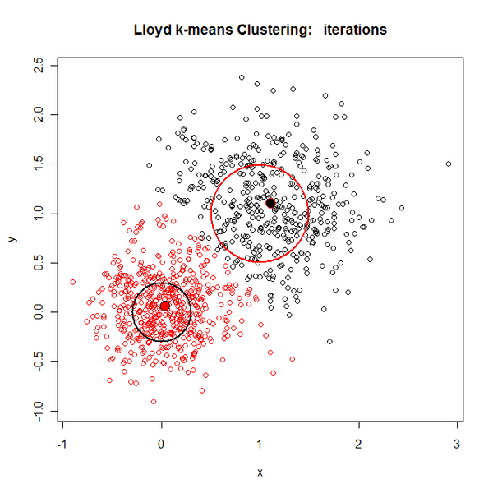
Example of clustering using 2 centers
Notes:
https://blog.revolutionanalytics.com/2011/06/kmeans-big-data.html

Slide 7
Goal
Use clustering algorithms on our significant genes to visually
The goal is to use clusters as evidence to support significant gene up and down regulation
Similar to PCA, we expect to see obvious clusters

